Slide 1
Unit 18
Bereavement and loss in maternity care

Slide 2
Introduction
Women often form attachments to their child early in the pregnancy and therefore a pregnancy loss can be emotionally devastating regardless of the gestational age of the fetus.
Early pregnancy loss, also referred to as spontaneous abortion or miscarriage, occurs in 10% of known pregnancies and occurs in the first 13 weeks of pregnancy.

Slide 3
Contd…
Supporting parents as they experience the devastating loss of their baby, be it before, during, or shortly after birth presents a particular challenge to the midwife.
The midwife must skilfully and compassionately meet the often considerable physical, emotional and psychological needs of women suffering loss, carry out correctly the subsequent paperwork and finally must be able to navigate their own feelings and reactions to the loss.

Slide 4
Contd…
In all settings, the long-term impact on the parents is profound and so the demands on the caring staff must be rightly set to a high standard of individualised and compassionate care.
Clear, honest and sensitive communication is key; ideally health professionals would be trained in, and have a good understanding of the many facets of bereavement care.

Slide 5
Though a multidisciplinary approach to perinatal bereavement is absolutely vital, the midwife will often carry out the majority of care for bereaved parents.
If care is not optimum and caregivers fail to meet the needs of bereaved parents, then the long term consequences to those parents may be negatively impact on the parents mental health, home life, future family life and even employment.

Slide 6
Contd…
It is crucial therefore that the midwives undertaking bereavement care are not only prepared for the complexities of such care, but that they receive the support required in order to bear the emotional and psychological cost of truly being with bereaved parents and ‘with woman’, as it is the heart of midwifery care.

Slide 7
Bereavement
Bereavement is the state of loss when someone close to an individual has died. The death of a loved one is one of the greatest sorrows that can occur in one's life.
People's responses to grief will vary depending upon the circumstances of the death, but grief is a normal, healthy response to loss.
Feelings of bereavement can also accompany other losses, such as the decline of one's health or the health of a close other, or the end of an important relationship.

Slide 8
Definition
“a broad term that encompasses the entire experience of family members and friends in the anticipation of death and subsequent adjustment to living following the death of a loved one (Christ Bonanno & Rubin 2003).

Slide 9
INTRA-UTERINE FETAL DEATH (IUFD)
Fetal death before onset of labour or fetus with no signs of life in utero after 22 weeks of gestation.
An infant delivered without signs of life after 20 weeks of gestation or weighing >500 gms when gestation age is not known.

Slide 10
INTRA-UTERINE FETAL DEATH (IUFD)
Still Birth - The definition recommended by WHO for international comparison is a baby born with no signs of life at or after 28 weeks‘ of gestation.
Still Birth;
Fresh (Intra-partum death) and
Macerated (Ante-partum death) (retained >12 hrs)
INCIDENCE : 4.5/1000 births

Slide 11
IMPACTS
Emotionally challenging for:
Doctors and Parents
Increases medico legal risk
Indicator of country’s health care system

Slide 12
CAUSES
No specific cause is found in 50% cases.
Known causes in %
Maternal 5-10,
Fetal 25-40,
Placental 20-35, and
Unexplained

Slide 13
MATERNAL CAUSES(RISK FACTORS)
Obesity, Maternal (>35yrs) age
Smoking/Alcohol/Drug abuse , Infections (malaria, hepatitis, influenza, syphilis, Toxoplasma, sepsis),
Medical ds –DM, HTN, Thyroid Diseases ,
Pre-existing diseases (Heart Diseases, Anaemia, Epilepsy) ,
Autoimmune Disorders (APS, SLE-Systemic lupus erythematosus ) , RH incompatibility , Hyperpyrexia ,Thrombophilias(an abnormal tendency to develop blood clots), Cholestasis , Abruption, PPROM(before 37WOG), multi-fetal gestation,
Labour related (preterm, dystocia, uterine rupture)
Notes:
APS(Anti-phospholipid syndrome)-disorder of the immune system which mistakenly creates antibodies that causes an increased risk of blood clots.
SLE-disorder of the immune system of the body mistakenly attacks healthy tissue. It can affect the skin, joints, kidneys, brain, and other organs
Cholestasis-decrease in bile flow due to impaired secretion by hepatocytes or to obstruction of bile flow through intra-or extrahepatic bile ducts.

Slide 14
CAUSES contd…
FETAL CAUSES : Multiple gestation , IUGR, Congenital anomalies, Infections, Hydrops (immune & non-immune), G6PD deficiency ,Birth Defects.
PLACENTAL CAUSES : Abruption, Cord accidents, Placental insufficiency, Placenta previa, Chorioamnionitis, PROM, Feto-maternal hemorrhage, Iatrogenic- ECV(External Cephalic Version), Drug overdoses.
Notes:
Collection of the fluid in the fetus – two compartment when the mother's immune system causes the baby's red blood cells to breakdown.
G6PD- glucose-6-phosphate dehydrogenases enzyme deficiency whih causes RBC breakdown.

Slide 15
DIAGNOSIS
Absence of fetal movements Signs:
Gradual retrogression of the height of the uterus
Uterine tone is diminished
Fetal movement are not felt during palpation
Fetal heart sound is not audible
USG
Notes:
Retrogression- declining from a better to a worse state, going backward.

Slide 16
Complications
– Infection
– PPH
– Retained placenta
– Abruption
– DIC
– Shock, renal failure
– Sepsis
– Maternal death
Notes:
Disseminated intravascular coagulation (DIC) is a condition in which blood clots form throughout the body, blocking small blood vessels. Symptoms may include chest pain, shortness of breath, leg pain, problems speaking, or problems moving parts of the body. As clotting factors and platelets are used up, bleeding may occur.This may include blood in the urine, blood in the stool, or bleeding into the skin. Complications may include organ failure.may be caused due to infection, retained placenta.

Slide 17
MANAGEMENT OF LABOUR AND BIRTH
• Recommendations about labour and birth should take into account the mother’s preferences as well as her medical condition and previous intrapartum history.
• Women should be strongly advised to take immediate steps towards delivery if there is sepsis, pre-eclampsia, placental abruption or membrane rupture, but a more flexible approach can be discussed if these factors are not present.
• Vaginal birth is the recommended mode of delivery for most women.

Slide 18
MANAGEMENT Contd…
More than 85% of women with an IUFD labour spontaneously within three weeks of diagnosis.
• Vaginal birth can be achieved within 24 hours of induction of labour for IUFD in about 90% of women.
• Caesarean birth might occasionally be clinically indicated by virtue of maternal condition.

Slide 19
Management cont…
Management of LABOUR INDUCTION
INTRA-PARTUM ANTIBIOTIC PROPHYLAXIS (Intravenous broad- spectrum antibiotic therapy )
PUERPERIUM
LACTATION; dopamine agonists successfully suppress lactation; Dopamine agonists should not be given to women with hypertension or pre-eclampsia and Estrogens should not be used to suppress lactation(due to risk for venous thrombo-embolism).
Notes:
Agonist-which works on receptors, Vitamin B6-suppressing the normally elevated prolactin hormone levels encountered during puerperium.

Slide 20
LEGAL ISSUES
Obstetricians and midwives should be aware of the law related to stillbirth.
Stillbirth must be medically certified by a fully registered doctor or midwife.
The doctor or midwife must have been present at the birth or examined the baby after birth.

Slide 21
PSYCHOLOGICAL AND SOCIAL ASPECTS OF CARE (BEREAVEMENT CARE)
Perinatal death is associated with increased rates of admission owing to postnatal depression.
Counseling should be offered to all women and their partners.
Parents should be advised about support groups.
Bereavement officers should be appointed to coordinate services.

Slide 22
FOLLOW UP
The wishes of the woman and her partner should be considered when arranging follow-up.
Women should be offered general pre-pregnancy advice.
Women should be advised to avoid weight gain.
Parents can be advised that the absolute chance of adverse events with a pregnancy interval less than 6 months remains low and is unlikely to be significantly increased compared with conceiving later.

Slide 23
Management of future pregnancy
Preconception or initial prenatal visit
Detailed medical and obstetric history
Evaluation and workup of previous stillbirth
Determination of recurrence risk
Smoking cessation
Weight loss in obese women (preconception only)
Genetic counseling if family genetic condition exists
Management of the Medical problems
Risk of recurrence is 7-10 / 1000 birth
Support and reassurance

Slide 24
STRATEGIES FOR PREVENTION
No sure fire method to prevent IUFD.
Loosing weight, life style modifications.
Women should try to optimize their health prior to pregnancy.
Enough Folic acid before they get pregnant.
Good preconception and prenatal care.
Women with medical problem (Timely treatment).
Educate women not to delay pregnancy.

Slide 25
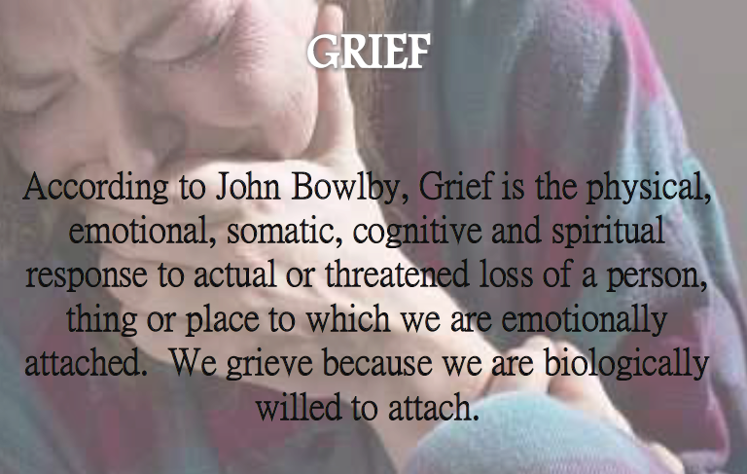
Grief counseling following IUFD/Stillbirth

Slide 26
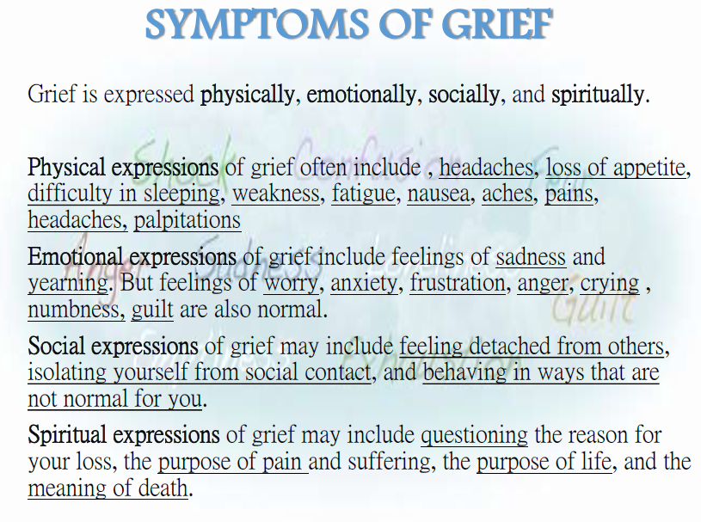

Slide 27
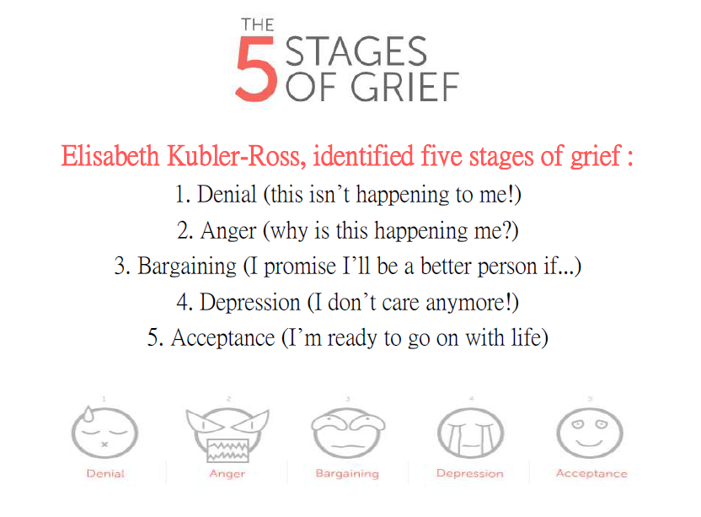

Slide 28
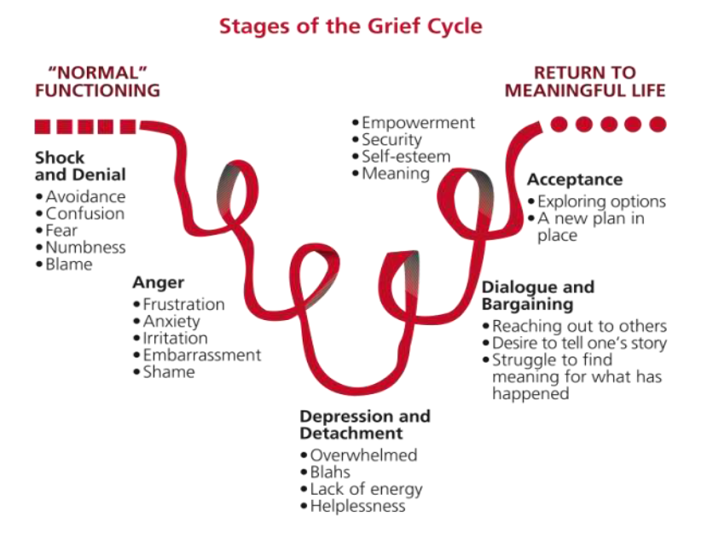
Notes:
Blahs-mid depression, anxiety. overwhelmed-bhabbibhal hunu.

Slide 29
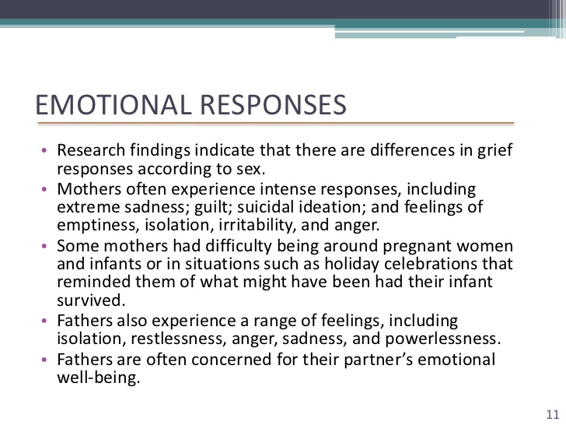

Slide 30
Strategies for grief counseling
Parents may feel so numb that they are unable to accept the news they have received.
A primary method for helping these parents is to give permission to express the pain of grief.
Mothers who experience the sudden death of a child tend to have more intense grief reactions than those mothers whose children die as a result of a chronic condition.
Mortality rate is higher and 20% mother experienced prolonged episode of depression and 1 in 5 mother suffer from post traumatic stress disorder.

Slide 31
Strategies for grief counseling
Male are less verbal about their grief, their grief has been underestimated.
Grief in father tends to peak around 30 months.
Father may try to mask their own grief in order to protect their wife.
Families need a chance to grieve separately as well as together.

Slide 32
Skills required for grief counselling
Active listening
Exploring beliefs
Providing information and support
Demonstrating empathy.
Note:It may be needed to refer couple for more specialized counselling in the case of an abnormal or prolonged bereavement. If possible, we can also offer follow-up visits and on-going support to the mother whose baby has died.

Slide 33
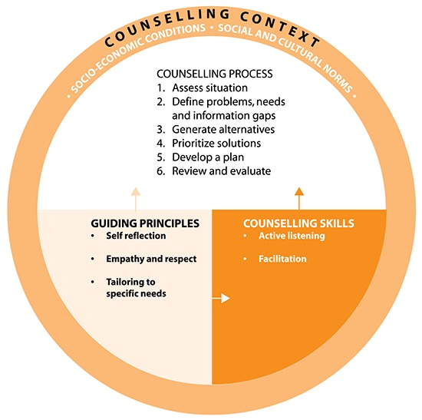

Slide 34
Contd…
Where a mother has had a IUD/stillbirth or the baby has died shortly after birth it is also needed to advise the mother on breast care under advice to women who are not breastfeeding and counsel her on an appropriate family planning methods and the importance of birth spacing.
Mothers who have lost their babies also need physical care just like any other woman after birth. Encourage her to rest and sleep and to make sure she eats well to regain her strength. Make sure she does not remain in a postnatal ward with other mothers who have just given birth.

Slide 35
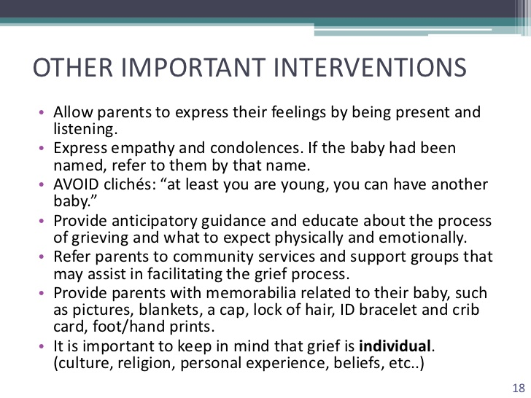
Notes:
Cliches-overused word which seems unnatural.

Slide 36


